Slide 1
Pulp and paper
Your Instructor – Patrick Willard

Slide 2
History of paper
Requirement 1
Tell the history of papermaking. Describe the part paper products play in our society and economy

Slide 3
The history of paper
Humans have been writing and drawing on things since before there was such an idea as ‘time’
The first written language, Cuneiform, was being used by the Sumerians in ancient Mesopotamia as early as the 31st century BCE!
Over 5000 years ago!
It was written on clay tablets that were baked in the sun
These tablets were heave and fragile. A better method was needed.

Slide 4
The history of paper
Many different items were used to write on besides paper, including
Papyrus – a reed in Egypt that was mashed together
Silk – a material primarily used for clothing in China
Parchment – Made from animal skins in Europe. Also knows as Vellum
Wood – Wood cuts would be made all over the globe
Bark – The Ojibwe people of the Great Lakes wrote the Wiigwaasabak on Birch bark
These materials though were still either heavy (wood and parchment), expensive (papyrus and parchment), or fragile (bark)

Slide 5
History of paper
Finally, in around 200 CE, paper was invented.
A Chinese official, Cai Lun figured out how to make a durable, cheap sheet of paper easily from common materials.
The paper industry was born!

Slide 6
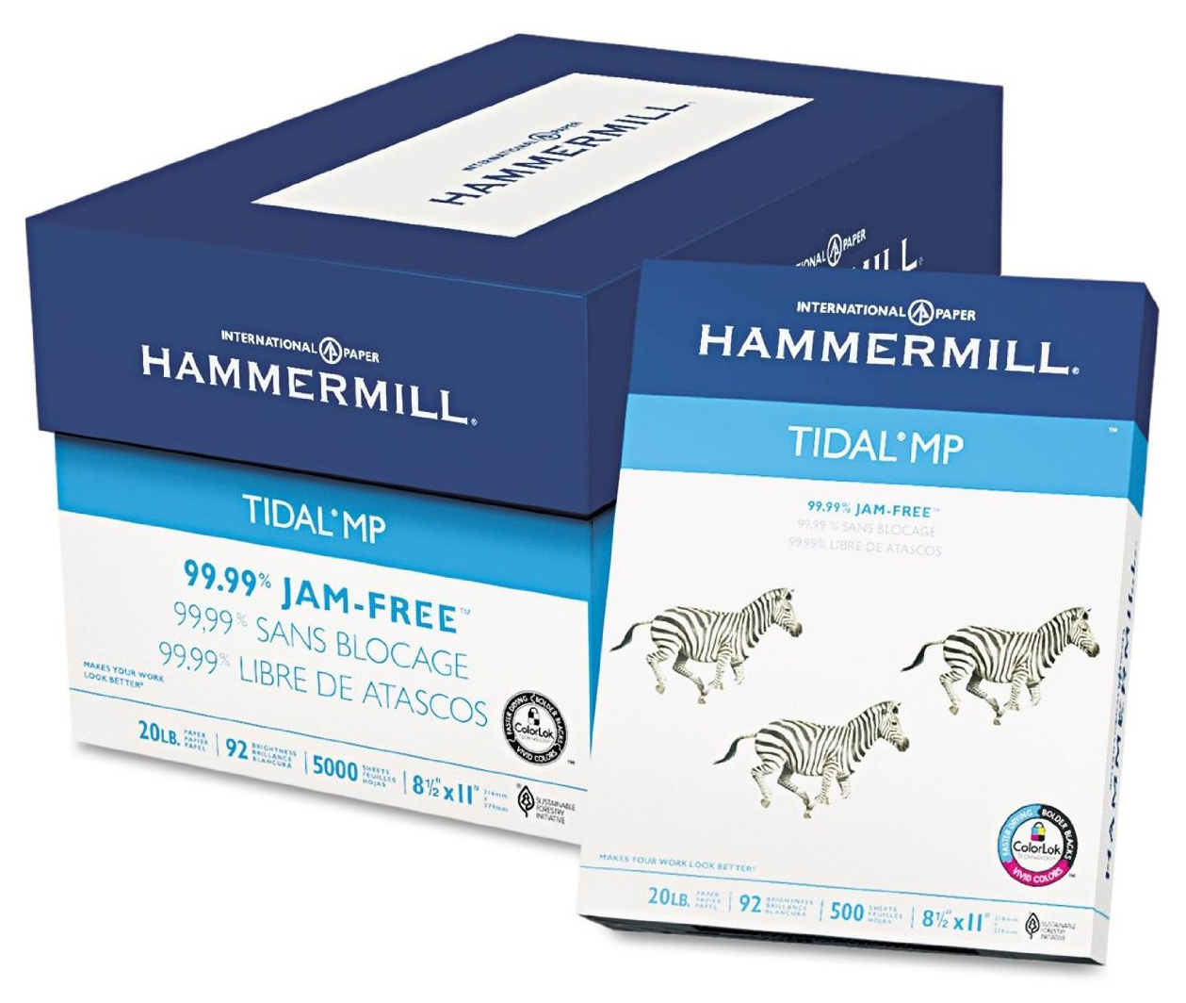
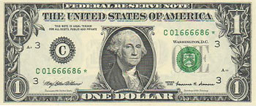
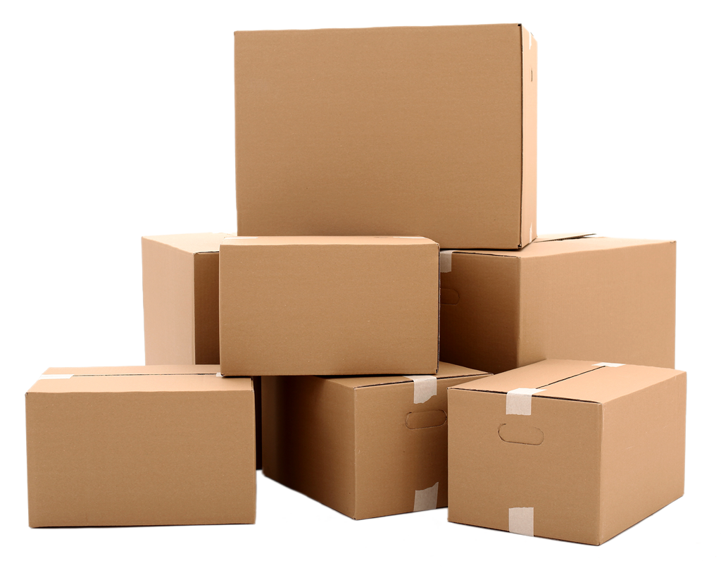
Paper in our economy
Paper and paper products play a large role in the world economy
Schools, offices and businesses all write down everything from invoices to homework on paper. Even in our ‘digital age’, companies keep paper backups, just in case.
Paper can also be used to create items of value – like money, or art
For packaging and construction – such as boxes, bags, envelopes and wrapping paper
For cleaning – Paper towels, facial tissue and… other uses…

Slide 7
The pulp and paper industry
Requirement 2
Learn about the Pulp and Paper Industry
A - Describe the ways the industry plants, grows and harvests trees.
B – Explain how the industry manages its forests so that the supply of trees keeps pace with the demand
C – Tell how the industry has incorporated the concepts of sustainable forest management (SFM)
D – Describe two ways the papermaking industry has addressed pollution

Slide 8
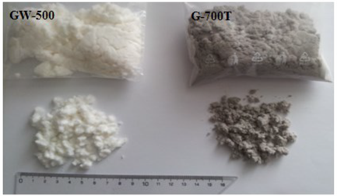
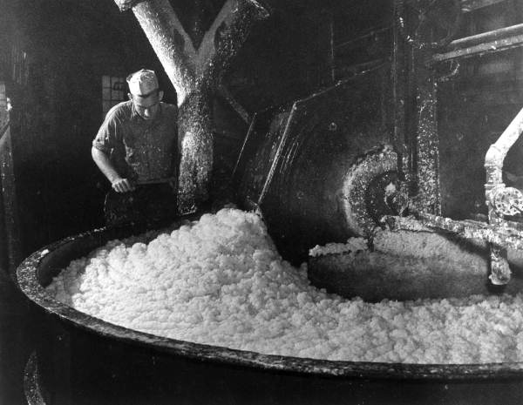
The pulp and paper industry
Where does paper come from?
Paper comes from a substance known as Wood Pulp.
Paper companies harvest trees from forests. However former practices such as ‘clear-cutting’ have mostly disappeared.

Slide 9
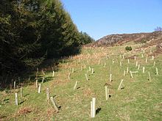
The pulp and paper industry
This Photo by Unknown Author is licensed under CC BY-SA
Old-style logging or Clear-Cutting would destroy the whole forest
Areas that paper companies harvest are known as ‘managed forests’. These forests are cut down at a sustainable rate, and many trees are replanted for every tree harvested.
According to the US Forest Service, the paper industry plant over 1.7 million trees and seeds PER DAY!
Yearly, all forestry related industries plant roughly 36% more trees annually than they harvest.
The logging of Old Growth forests accounts for under 10% of all logging, and most of that material goes towards construction, not the pulp and paper industry.
Modern, managed forests provide habitat for animals and a sustainable source of materials

Slide 10
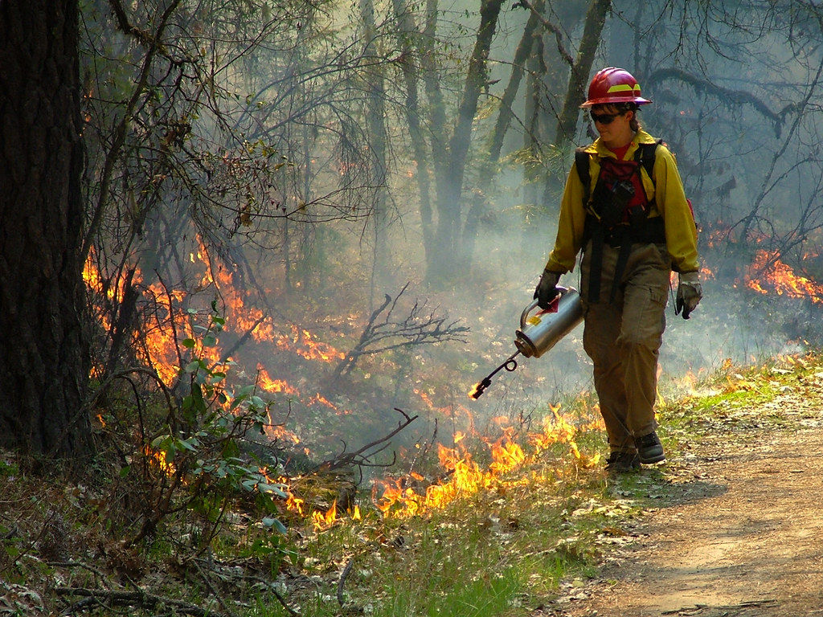
The pulp and paper industry
Sustainable Forest Management is the idea of taking into account ALL of the factors that have to do with a forest. Including the timber, other species in the forest, watersheds and the people who live near the forest.
Forests can be managed by pruning trees instead of cutting them down
Cutting down older or dying trees
Thinning populations of abundant trees
Using controlled burns to regenerate the forest
Making sure that waste does not go into the water table
Working with local communities to ensure cultural preservation

Slide 11
The pulp and paper industry
In the past the pulp and paper industry has polluted quite a bit. But things have changed.
In the US, the Pulp and Paper Industry represents 5% of all industrial pollutants.
In the past 40 years, paper consumption has risen by 400%!
However using Sustainable Forest Management, recycling paper, and EPA oversight have all started to lessen the impact on the environment.
Regulations such as the Clean Water Act and the National Pollutant Discharge Elimination System set guidelines for how many pollutants can go into our air and water.

Slide 12
Tree harvesting and pulping
Requirement 3
Name at least four types of trees that are major sources of papermaking fibers. Then do the following:
A - Discuss what other uses are made of the trees and the forestland owned by the pulp and paper industry
B - Describe two ways of getting fibers from wood, and explain the major differences between them.
C - Tell why some pulps are bleached, and describe the process

Slide 13
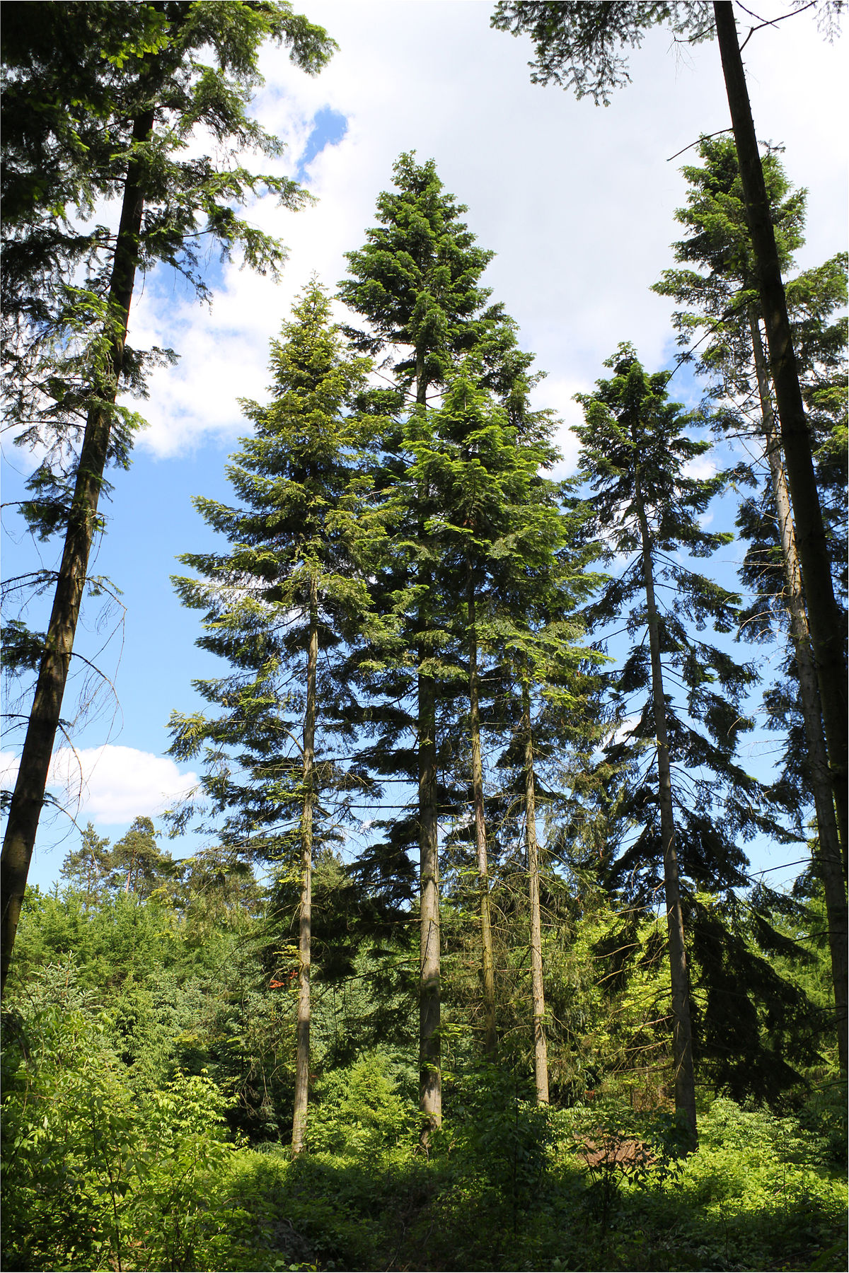
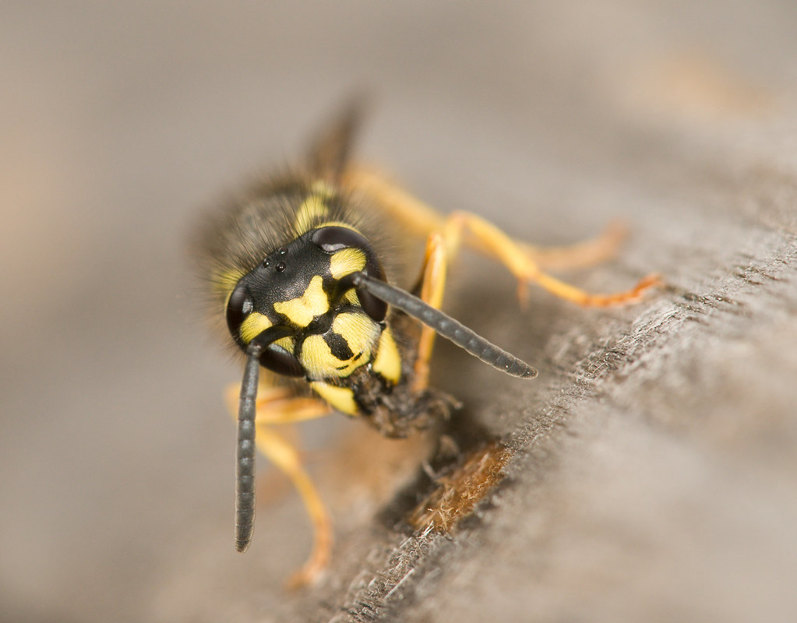
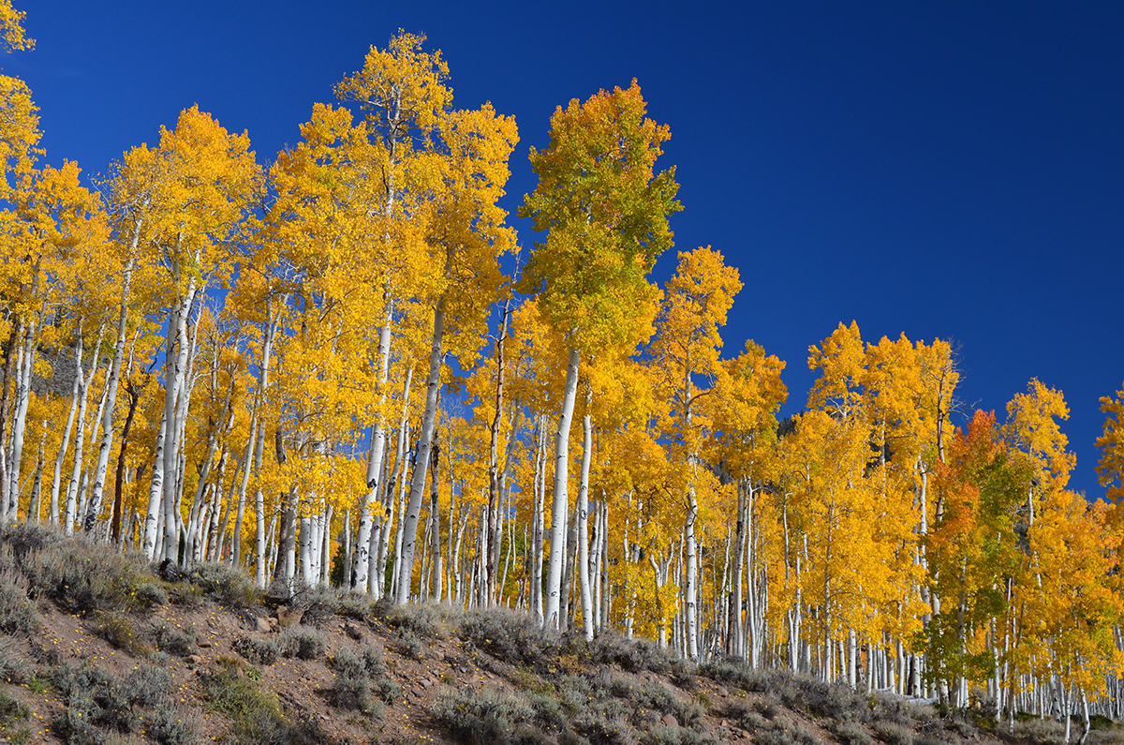
Tree types
Back in Cai Lun’s day, they used Mulberry Trees native to the Yangtze River Valley.
Any tree can be made into pulp and paper, but Coniferous trees are the trees of choice because they have long, strong cellulose fibers which make for stronger paper.
Common papermaking trees are:
Spruce
Pine
Fir
Hemlock
Aspen
Birch
Wood Pulp
A natural Papermaker
Fir Trees
Aspen Trees

Slide 14
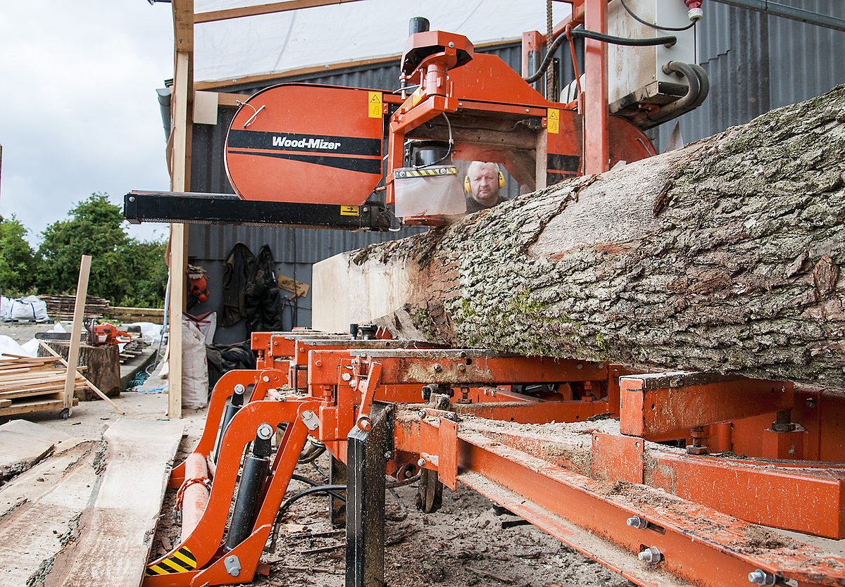
Tree harvesting and pulping
The trees from the forestland owned by pulp and paper companies has a wide variety of uses beyond paper and pulp.
Furniture is made from the trees
Timber from trees is often purchased by lumber mills and construction companies
Leaves and twigs and bark are ground into mulch
Other by-products include gum and shoe polish from the tree sap, dyes, soap glue and more.
Because Pulp and Paper companies grow conifers, lumber mills will purchase the trunks to make beams for homes and buildings

Slide 15
Two ways to pulp trees
Mechanical Process
Chemical Process
Uses a spinning grindstone to separate the fibers.
Great for newsprint and other, lower quality fibers.
Not good for finer papers or thicker paper products.
Chippers run machines that chip the wood into small pieces
Digesters boil the wood bits with certain chemicals that break down the wood.
As the heat builds, pressure builds and the fibers separate from the remaining wood.
The remaining pulp is washed of impurities.

Slide 16
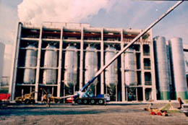
Why is the pulp bleached sometimes?
Bleaching the wood pulp is a process used for two main reasons:
To make the pulp (and the finished paper) a more uniform color
To make the pulp (and the finished paper) a whiter color
There are two ways to chemically bleach the pulp.
Uses certain chemicals to destroy the color of the wood pup (such as Chlorine mixes)
This allows for a less bright, but higher yield batch of paper
Removes almost all of the lignin in the pulp.
Lignin is an organic polymer in the wood, making them sturdy
This process creates a brighter paper, but a lower yield due to lignin removal.

Slide 17
Time to make the paper
Requirement 4
Describe how paper is made. Discuss how paper is recycled. Make a sheet of paper by hand.

Slide 18
Time to make the paper
Paper is made by mixing up vegetable or tree fibers, cooking them in hot water until soft, but not dissolved and then adding a base chemical such as lye to soften the fibers and make them pliable.
You then pass this pulp through a screen, let the water drip away / squeeze off the water and a layer of wet paper is left behind.
Dry this wet paper and it is ready for use!

Slide 19
Time to make the paper
To make recycled paper, you basically just do the last steps of making fresh paper.
Use mechanical or chemical means to break down the waste paper with hot water, creating pulp.
Put the pulp through a mesh screen to create a wet paper
Let the paper dry!

Slide 20
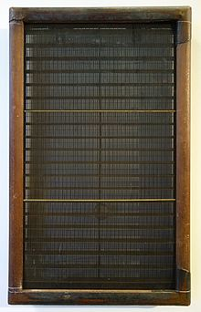
Time to make the paper
To make your paper you are going to need some items:
A mold – 2 old picture frames
A deckle – an old piece of window screening
OR a Spatter Guard
A drill or hammer / 2 screws or 2 nails
A stapler and staples
A blender or food processer
Some old paper
A washbasin that your mold can fit in
Water
Paper towels

Slide 21
Time to make the paper

Slide 22
Coated paper
Requirement 5
. Explain what coated paper is and why it is coated. Describe the major uses for different kinds of coated papers. Describe one other way that paper is changed by chemical or mechanical means to make new uses possible.

Slide 23
Coated paper
Coated paper is paper that has been coated by a compound or polymer to give it certain qualities.
These can include
Extra weight
Surface gloss
Smoothness
Reduced ink absorbency
High quality printing papers use Kaolinite, Calcium Carbonate, Bentonite and others to coat papers for the packaging industry and magazines
Coatings can also contain resins and other chemical additives to give water resistance and protect it against radiation

Slide 24
Pulp and Paper products
Requirement 6
Make a list of 15 pulp or paper products found in your home. Share examples of 10 such products with your counselor.
__________
__________
__________
__________
__________
__________
__________
__________
__________
10. __________
11. __________
12. __________
13. __________
14. __________
15. __________

Slide 25
Visiting a pulp mill
Requirement 7
A - Visit a pulp mill. Describe how the mill converts wood to cellulose fibers.

Slide 26
Careers in pulp and paper
Find out about three career opportunities in the papermaking industry that interest you. Pick one and find out the education, training, and experience required for this profession. Discuss this with your counselor, and explain why this profession might interest you.
By converting plants and wood into paper, you can be part of a career that makes everything from cardboard boxes to napkins to wallpaper to printer paper
Roughly one quarter of the professionals in the industry have maintenance, professional, administrative and clerical jobs.
There are also mechanical and chemical engineers, foresters and lumberjacks, and truckers who transport the logs.

Slide 27
Careers in pulp and paper
Pick one of these careers, or one from your own research and find out the education, training, and experience required for this profession. Discuss this with your counselor, and explain why this profession might interest you.

