Slide 1
Moviemaking
Jordan McCandless

Slide 2
Why moviemaking?
Enjoy movies & visual storytelling!
Moviemaking as a profession
Video production as a tool & hobby

Slide 3
Class expectations
Active participation
No more, no less
If you have a question, ask
Give feedback
Appropriate content
Scout Oath/Law

Slide 4
Requirements & schedule
The What, When, and How …

Slide 5
Badge requirements
Discuss and demonstrate the proper elements of a good motion picture. In your discussion, include visual storytelling, rhythm, the 180-axis rule, camera movement, framing and composition of camera shots, and lens selection.

Slide 6
Badge requirements
Do the following:
In a three-or four-paragraph treatment, tell the story you plan to produce, making sure that the treatment conveys a visual picture
Prepare a storyboard for your motion picture. (This can be done with rough sketches and stick figures.)

Slide 7
Badge requirements
Do the following:
Demonstrate the following motion picture shooting techniques:
Using a tripod
Panning a camera
Framing a shot
Selecting an angle
Selecting proper lighting
Handheld shooting

Slide 8
Badge requirements
Do the following:
Using motion picture shooting techniques, plan one of the following programs. Start with a treatment and complete the requirement by presenting this program to a pack or your troop, patrol, or class.
Film or videotape a court of honor and show it to an audience.
Create a short feature of your own design, using the techniques you learned.
Shoot a vignette that could be used to train a new Scout in a Scouting skill.

Slide 9
Badge requirements
Do ONE of the following:
With your parent’s permission and your counselor’s approval, visit a film set or television production studio and watch how production work is done.
Explain to your counselor the elements of the zoom lens and three important parts.
Find out about three career opportunities in moviemaking. Pick one and find out the education, training, and experience required for this profession. Discuss this career with your counselor. Explain why this profession might interest you.

Slide 10
Class schedule
Monday
Class Intro & Elements of Moviemaking
Tuesday
Tools of Moviemaking: Treatments, Storyboards, Shot Techniques, & Lenses
Wednesday
Careers in Moviemaking
Thursday
Demonstration Day
Friday
Demonstration Day (as needed)
HW: Requirement 4
HW: Demonstrate Requirement 1

Slide 11
questions
Jordan McCandless
jordan.mccandless@scouting.org

Slide 12
Elements of moviemaking
What goes into making a good movie?

Slide 13
Elements of moviemaking
Visual storytelling
Rhythm
180-axis rule
Camera movement
Framing & shot composition
Lens selection
Other elements to consider

Slide 14
Visual storytelling

Slide 15
rhythm
Does the film flow logically or smoothly from scene to scene?
Do the cuts make sense?

Slide 16
180-axis rule

Slide 17
Camera movement

Slide 18
Framing & shot composition
Framing
What’s at the edges of the screen?
Shot composition
What is in the shot?
Where is it at in the shot?
Does this help or hinder the story or mood?

Slide 19
Rule of thirds

Slide 20
Lens selection
Lenses offer:
Narrower/Wider shots
More/Less light
Better close-ups/distance shots
Better depth-of-field (focus/sharpness of features in front or behind subject)
Ability to communicate different details
F-stop & Mm - See the difference
F-stop - the amount of light a lens lets in
Mm – A lens’ telephoto/zoom capability

Slide 21
Other elements to consider …
Pacing
Script
Production Design
Casting
Editing

Slide 22
homework
Everything you need to do …

Slide 23
homework
Using the provided form, demonstrate each element of moviemaking:
Visual storytelling
Rhythm
180-axis rule
Camera movement
Framing & composition of camera shots
Lens selection

Slide 24
questions
Jordan McCandless
jordan.mccandless@scouting.org

Slide 25
Moviemaking
Jordan McCandless

Slide 26
Class schedule
Monday
Class Intro & Elements of Moviemaking
Tuesday
Tools of Moviemaking: Treatments, Storyboards, Shot Techniques, & Lenses
Wednesday
Careers in Moviemaking
Thursday
Demonstration Day
Friday
Demonstration Day (as needed)
HW: Requirement 4
HW: Demonstrate Requirement 1

Slide 27
Tools of Moviemaking
What to use to prepare and make your movie …

Slide 28
Tools of moviemaking
Treatments
Storyboards
Camera shot techniques
Zoom lens

Slide 29
Treatments & storyboards
Treatment
A brief description of the story/movie/video you plan to shoot
Conveys a visual picture of what you want the movie to look like
Includes the major scenes and events of your film
A “sales pitch” and guide for your film
Storyboard
A visual sketch of each scene in the movie
Provides a visual guide for shooting each scene

Slide 30
Example - treatment

Slide 31
Example - storyboard

Slide 32
Shot techniques

Slide 33
Zoom lens

Slide 34
questions
Jordan McCandless
jordan.mccandless@scouting.org

Slide 35
homework
Everything you need to do …

Slide 36
Homework
Pick one of these professions in moviemaking that interests you:
Director of Photography (Cinematographer)
Camera Operator
Producer
Director
Casting Director
Location Manager
Screenwriter
Set Designer
Costume Designer
Special Effects Technician
Stunt Coordinator
Stunt Actor
Actor

Slide 37
Moviemaking
Jordan McCandless

Slide 38
Class schedule
Monday
Class Intro & Elements of Moviemaking
Tuesday
Tools of Moviemaking: Treatments, Storyboards, Shot Techniques, & Lenses
Wednesday
Careers in Moviemaking
Thursday
Demonstration Day
Friday
Demonstration Day (as needed)
HW: Requirement 4
HW: Demonstrate Requirement 1

Slide 39
Careers in moviemaking
How to make movies and make a living!

Slide 40
Careers in moviemaking
Director of Photography (Cinematographer)
Camera Operator
Producer
Director
Casting Director
Location Manager
Screenwriter
Set Designer
Costume Designer
Special Effects Technician
Stunt Coordinator
Stunt Actor
Actor

Slide 41
Director of photography (cinematographer)
The person filming with a camera. Supervises the film’s camera and lighting crews. Responsible for making technical and artistic decisions related to the images. The final decision-maker on lighting and framing.
Education & Training: Film school; Camera training workshops or programs can help build camera skills; Shoot your own films/videos.
Experience: Understand camera and lighting departments; good interpersonal skills; experience coordinating and managing a team; Study film history, photography, etc.

Slide 42
Camera operator
Solely responsible for physically operating the camera and for framing during a shot. Works with the Director of Photography, Director, and Actors to decide on camera set-ups (angles, lenses etc.) and tracking moves (dollies, cranes etc.) to best capture a scene.
Education & Training: No specific degree or training required; Important to understand how a camera works; Workshops or training in using a camera are useful (i.e. video camera or even photography).
Experience: Internships or experience working at a camera shop can help; Important to fully understand how a camera works; film set experience.

Slide 43
producer
People in control of the production. Producers decide which films to make, set the date for filming, find money for financing, and make planning decisions. In charge of hiring the Director and helping hire the crew. With the Director, plans the movie, develops the screenplay, decides on budget and shooting schedule.
Education & Training: No specific degree or training required; Education or training in business can be helpful; Film school can be helpful.
Experience: Interpersonal skills are important; experience running a small business; Delegation skills; business skills and project management experience.

Slide 44
director
Makes the majority of creative decisions in making the film. Determines a film’s look, feel, and sound. Can make script edits or changes (or ask the writer to make them).
Education & Training: Typically a 4-year degree is required; degree or training in film or cinema is positive; Other helpful degree subjects include communications, acting, writing, journalism.
Experience: a thorough understanding of the filmmaking process is important; Knowledge of film history can be helpful; Experience working on a film set or in a filmmaking department or industry is valuable.

Slide 45
Casting director
Decide which actors should play each part. Brings ideas to the Producers and Director.
Education & Training: No required training or degree but a formal degree can be helpful in opening up opportunities.
Experience: Background in communications can be useful; a background or experience in acting can help, as well as backgrounds in theatre since a Casting Director needs to have an eye for acting talent.

Slide 46
Location manager
Look for places to shoot the various scenes in the film and gets permission to use them. Looks for locations that fit the setting of the film or specific scenes.
Education & Training: No formal degree or training required; Interpersonal skills and ability to interact well with people is important; Need to know how to read contracts, take photos, drive etc.
Experience: No specific experience required, but having an eye for geography or terrain and the ability to visualize possibilities is helpful.

Slide 47
screenwriter
Takes an original idea or adapts a book (or other source) into a screenplay and/or written treatment of the film. Rewrites and revises the script depending on the Director’s input and desires.
Education & Training: No specific required degree or training, BUT writing and understanding of screenwriting structure is crucial; a degree in Writing or certification in writing or screenwriting can be very useful.
Experience: Writing experience; understand filmmaking & the screenwriting style.

Slide 48
Set designers
Develop sketches and models to design the set for a film. May require high levels of research and detail to match a historical setting or time period, match descriptions from a book etc.
Education & Training: No required degree or training; Education or training in art or construction helps; Training with computer graphics technology; General drawing and building skills.
Experience: Experience drawing or building models; Construction experience; Architecture experience.

Slide 49
Costume designer
Design and create the costumes for each character. Research is done to ensure accuracy and detail. Sometimes a costume must have several different versions created to reflect changes during a scene or the film itself.
Education & Training: Costume design classes or programs, Theatre programs; No formal degree/training required.
Experience: Sew, eye for detail and character, knowledge of different fashion styles, knowledge of historical fashion styles.

Slide 50
Special effects technician
Use computer graphics or practical tools to create effects such as explosions, weather, crashes, computer-generated characters or creatures.
Education & Training: A four-year degree is often required; Degrees in art or fine art, computer graphics, animation, sculpture, special effects, visual effects etc.; Film school can be helpful.
Experience: Experience working with pyrotechnics; Experience in construction or physical arts like sculpture, architecture, film set experience.

Slide 51
Stunt coordinator
Coordinates and choreographs all stunts (crashes, explosions, fights, action sequences etc.) and hires the Stunt Actors to work the scenes considered too high-risk for the Actor.
Education & Training: No specific degree or program required; Training in martial arts or gymnastics; Skill or experience in driving different kinds of vehicles.
Experience: Experience with film stunts. A martial arts background or professional driving background can be helpful.

Slide 52
Stunt actor
Also referred to as a “stunt double” since they replace the Actor for scenes or sequences deemed too risky for the Actor to perform (such as fight scenes, explosions or scenes with high-risk effects, etc).
Education & Training: No specific degree or training required; Martial arts, gymnastics, driving maneuvers and other training very helpful.
Experience: Experience and comfort being on camera; set etiquette; experience in a martial art or physical art or activity can be helpful.

Slide 53
actor
The actor is the person who plays one of the characters or roles in a film.
Education & Training: No required degree or training; A degree or training in acting or dramatic performance can be helpful; Theatre degree; Conservatory programs; Film school.
Experience: Can vary depending on the role; Backgrounds and experience of all kinds can be useful; experience acting is most helpful, e.g. acting in a school or community play. Experience performing can always be helpful.

Slide 54
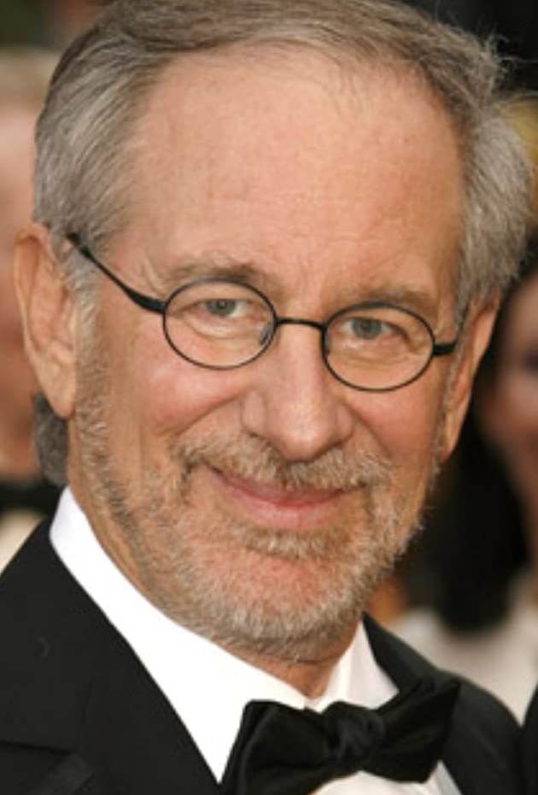
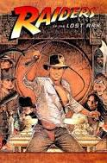
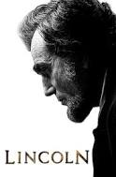
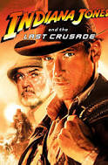
Steven spielberg

Slide 55
Steven spielberg

Slide 56
More information about careers
CareersinFilm.com
Explore your school, local community colleges, universities etc.

Slide 57
homework
Everything you need to do …

Slide 58
Homework
Work on your video assignments (Requirements 1, 2) submit to me to share with each other tomorrow.

Slide 59
Moviemaking
Jordan McCandless

