Slide 1
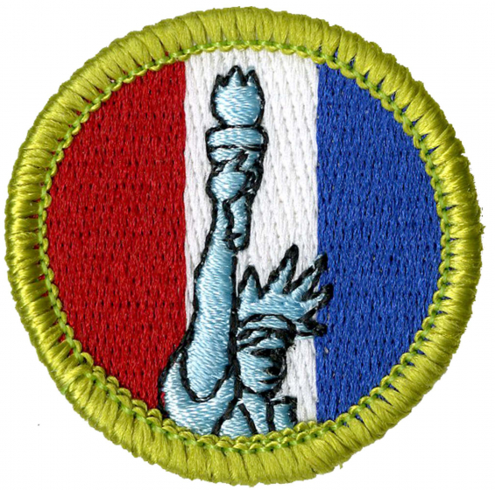
American Heritage
Jordan McCandless
Jordan.mccandless@scouting.org

Slide 2
Why American Heritage?
Interested in history generally or U.S. history in particular
How did we (the United States) get here?
How does the past shape the present?

Slide 3
Requirements & Expectations

Slide 4
Class Expectations
Active participation
No more, no less
If you have a question, ask
Give feedback
Scout Oath/Law

Slide 5
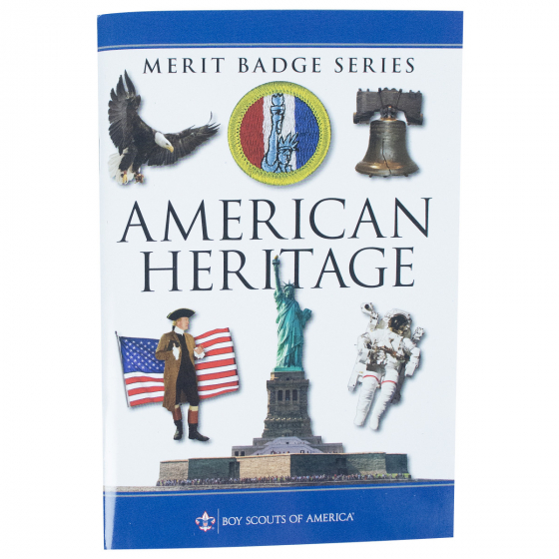
Requirements

Slide 6
Requirement 1
Read the Declaration of Independence. Pay close attention to the section that begins with “We hold these truths to be self-evident” and ends with “to provide new Guards for their future security.”
Rewrite that section in your own words, making it as easy to understand as possible.
Then, share your writing with your merit badge counselor and discuss the importance of the Declaration to all Americans.

Slide 7
Requirement 2
Do TWO of the following:
Select two individuals from American history, one a political leader (a president, senator, etc.) and the other a private citizen (a writer, religious leader, etc.). Find out about each person’s accomplishments and compare the contributions each has made to America’s heritage.
With your counselor’s approval, choose an organization that has promote some type of positive change in American society. Find out why the organization believed this change was necessary and how it helped to accomplish the change. Discuss how this organization is related to events or situations from America’s past.
With your counselor’s approval, interview two veterans of the U.S. military. Find out what their experiences were like. Ask the veterans what they believe they accomplished.
With your counselor’s approval, interview three people in your community of different ages and occupations. Ask these people what America means to them, what they think is special about this country, and what American traditions they feel are important to preserve.

Slide 8
Requirement 3
Do the following:
Select a topic related to the United States that is currently in the news. Describe to your counselor what is happening. Explain how today’s events are related to or affected by the events and values of America’s past.
For each of the following, describe its adoption, tell about any changes since its adoption, and explain how each one continues to influence Americans today: the flag, the Pledge of Allegiance, the Great Seal of the United States, the motto, and the national anthem.
Research your family’s history. Find out how various events and situations in American history affected your family. If your family immigrated to America, tell the reasons why. Share what you find with your counselor.

Slide 9
Requirement 4
Do TWO of the following:
Explain the National Register of Historic Places and how a property becomes eligible for listing in the National Register of Historic Places. Make a map of your local area, marking the points of historical interest. Tell about any National Register properties in your area. Share the map with your counselor, and describe the historical points you have indicated.
Research an event of historical importance that took place in or near your area. If possible, visit the place. Tell your counselor about the event and how it affected local history. Describe how the area looked then and what it now looks like.
Find out when, why, and how your town or neighborhood started, and what ethnic, national, or racial groups played a part. Find out how the area has changed over the past 50 years and try to explain why.

Slide 10
Requirement 4 (CONT.)
Do TWO of the following:
Take an active part in a program about an event or person in American history. Report to your counselor about the program, the part you took, and the subject.
Visit a historic trail or walk in your area. After your visit, share with your counselor what you have learned. Discuss the importance of this location and explain why you think it might qualify for National Register listing.

Slide 11
Requirement 5
Do ONE of the following:
Watch two motion pictures (with the approval and permission of your counselor and parent) that are set in some period of American history. Describe to your counselor how accurate each film is with regard to the historical events depicted and also with regard to the way the characters are portrayed.
Read a biography (with your counselor’s approval) of someone who has made a contribution to America’s heritage. Tell some things you admire about this individual and some things you do not admire. Explain why you think this person has made a positive or a negative contribution to America’s heritage.
Listen to recordings of popular songs from various periods of American history. Share five of these songs with your counselor, and describe how each song reflects the way people felt about the period in which it was popular. If a recording is not available, have a copy of the lyrics available.

Slide 12
Requirement 6
Discuss with your counselor the career opportunities in American heritage.
Pick one that interests you and explain how to prepare for this career.
Discuss what education and training are required for this career.

Slide 13
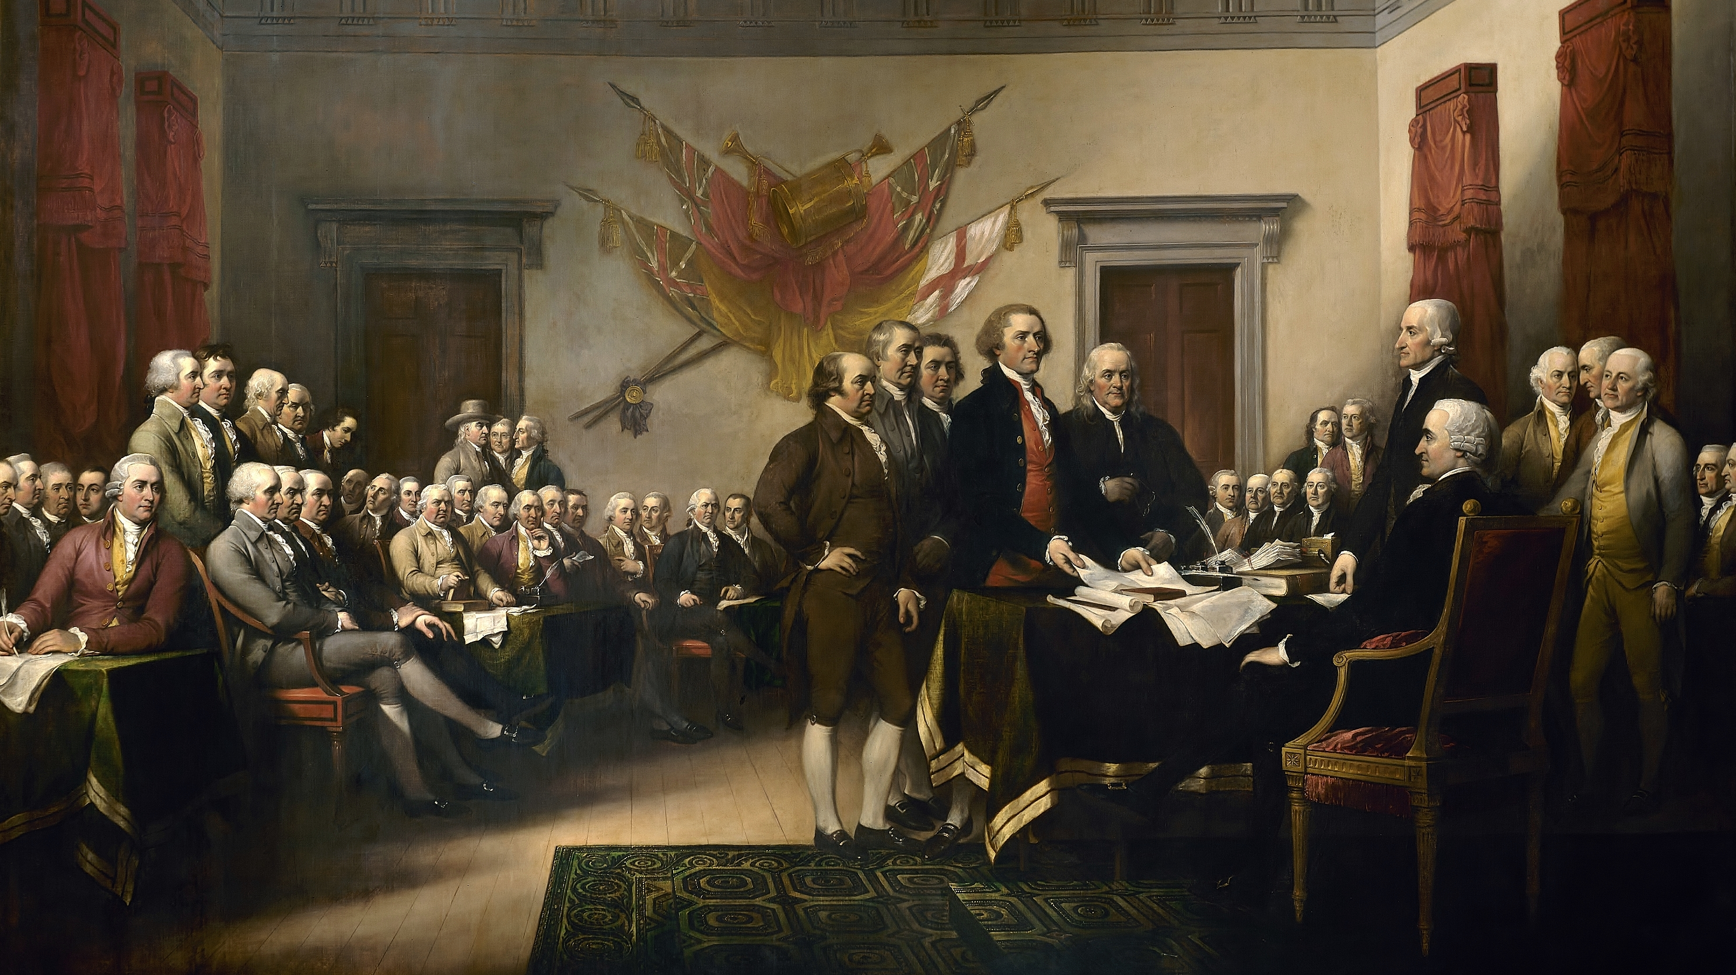
The Declaration of Independence

Slide 14
In Congress, July 4, 1776.
The unanimous Declaration of the thirteen united States of America, When in the Course of human events, it becomes necessary for one people to dissolve the political bands which have connected them with another, and to assume among the powers of the earth, the separate and equal station to which the Laws of Nature and of Nature's God entitle them, a decent respect to the opinions of mankind requires that they should declare the causes which impel them to the separation.

Slide 15
We hold these truths to be self-evident, that all men are created equal, that they are endowed by their Creator with certain unalienable Rights, that among these are Life, Liberty and the pursuit of Happiness.--That to secure these rights, Governments are instituted among Men, deriving their just powers from the consent of the governed, --That whenever any Form of Government becomes destructive of these ends, it is the Right of the People to alter or to abolish it, and to institute new Government, laying its foundation on such principles and organizing its powers in such form, as to them shall seem most likely to effect their Safety and Happiness.

Slide 16
Prudence, indeed, will dictate that Governments long established should not be changed for light and transient causes; and accordingly all experience hath shewn, that mankind are more disposed to suffer, while evils are sufferable, than to right themselves by abolishing the forms to which they are accustomed. But when a long train of abuses and usurpations, pursuing invariably the same Object evinces a design to reduce them under absolute Despotism, it is their right, it is their duty, to throw off such Government, and to provide new Guards for their future security.

Slide 17
QUESTIONS

Slide 18
Such has been the patient sufferance of these Colonies; and such is now the necessity which constrains them to alter their former Systems of Government. The history of the present King of Great Britain is a history of repeated injuries and usurpations, all having in direct object the establishment of an absolute Tyranny over these States. To prove this, let Facts be submitted to a candid world.

Slide 19
He has refused his Assent to Laws, the most wholesome and necessary for the public good.
He has forbidden his Governors to pass Laws of immediate and pressing importance, unless suspended in their operation till his Assent should be obtained; and when so suspended, he has utterly neglected to attend to them.
He has refused to pass other Laws for the accommodation of large districts of people, unless those people would relinquish the right of Representation in the Legislature, a right inestimable to them and formidable to tyrants only.

Slide 20
He has called together legislative bodies at places unusual, uncomfortable, and distant from the depository of their public Records, for the sole purpose of fatiguing them into compliance with his measures.
He has dissolved Representative Houses repeatedly, for opposing with manly firmness his invasions on the rights of the people.
He has refused for a long time, after such dissolutions, to cause others to be elected; whereby the Legislative powers, incapable of Annihilation, have returned to the People at large for their exercise; the State remaining in the mean time exposed to all the dangers of invasion from without, and convulsions within.

Slide 21
He has endeavoured to prevent the population of these States; for that purpose obstructing the Laws for Naturalization of Foreigners; refusing to pass others to encourage their migrations hither, and raising the conditions of new Appropriations of Lands.
He has obstructed the Administration of Justice, by refusing his Assent to Laws for establishing Judiciary powers.
He has made Judges dependent on his Will alone, for the tenure of their offices, and the amount and payment of their salaries.

Slide 22
He has erected a multitude of New Offices, and sent hither swarms of Officers to harrass our people, and eat out their substance.
He has kept among us, in times of peace, Standing Armies without the Consent of our legislatures.
He has affected to render the Military independent of and superior to the Civil power.

Slide 23
He has combined with others to subject us to a jurisdiction foreign to our constitution, and unacknowledged by our laws; giving his Assent to their Acts of pretended Legislation:
For Quartering large bodies of armed troops among us:
For protecting them, by a mock Trial, from punishment for any Murders which they should commit on the Inhabitants of these States:

Slide 24
For cutting off our Trade with all parts of the world:
For imposing Taxes on us without our Consent:
For depriving us in many cases, of the benefits of Trial by Jury:
For transporting us beyond Seas to be tried for pretended offences

Slide 25
For abolishing the free System of English Laws in a neighbouring Province, establishing therein an Arbitrary government, and enlarging its Boundaries so as to render it at once an example and fit instrument for introducing the same absolute rule into these Colonies:
For taking away our Charters, abolishing our most valuable Laws, and altering fundamentally the Forms of our Governments:
For suspending our own Legislatures, and declaring themselves invested with power to legislate for us in all cases whatsoever.

Slide 26
He has abdicated Government here, by declaring us out of his Protection and waging War against us.
He has plundered our seas, ravaged our Coasts, burnt our towns, and destroyed the lives of our people.
He is at this time transporting large Armies of foreign Mercenaries to compleat the works of death, desolation and tyranny, already begun with circumstances of Cruelty & perfidy scarcely paralleled in the most barbarous ages, and totally unworthy the Head of a civilized nation.

Slide 27
He has constrained our fellow Citizens taken Captive on the high Seas to bear Arms against their Country, to become the executioners of their friends and Brethren, or to fall themselves by their Hands.
He has excited domestic insurrections amongst us, and has endeavoured to bring on the inhabitants of our frontiers, the merciless Indian Savages, whose known rule of warfare, is an undistinguished destruction of all ages, sexes and conditions.

Slide 28
In every stage of these Oppressions We have Petitioned for Redress in the most humble terms: Our repeated Petitions have been answered only by repeated injury. A Prince whose character is thus marked by every act which may define a Tyrant, is unfit to be the ruler of a free people.

Slide 29
Nor have We been wanting in attentions to our Brittish brethren. We have warned them from time to time of attempts by their legislature to extend an unwarrantable jurisdiction over us. We have reminded them of the circumstances of our emigration and settlement here. We have appealed to their native justice and magnanimity, and we have conjured them by the ties of our common kindred to disavow these usurpations, which, would inevitably interrupt our connections and correspondence. They too have been deaf to the voice of justice and of consanguinity. We must, therefore, acquiesce in the necessity, which denounces our Separation, and hold them, as we hold the rest of mankind, Enemies in War, in Peace Friends.

Slide 30
We, therefore, the Representatives of the united States of America, in General Congress, Assembled, appealing to the Supreme Judge of the world for the rectitude of our intentions, do, in the Name, and by Authority of the good People of these Colonies, solemnly publish and declare, That these United Colonies are, and of Right ought to be Free and Independent States; that they are Absolved from all Allegiance to the British Crown, and that all political connection between them and the State of Great Britain, is and ought to be totally dissolved; and that as Free and Independent States, they have full Power to levy War, conclude Peace, contract Alliances, establish Commerce, and to do all other Acts and Things which Independent States may of right do. And for the support of this Declaration, with a firm reliance on the protection of divine Providence, we mutually pledge to each other our Lives, our Fortunes and our sacred Honor.

Slide 31
QUESTIONS

Slide 32
Symbols of the United States

Slide 33
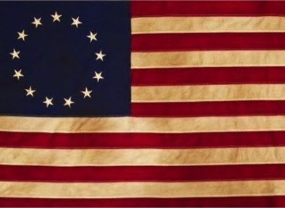
The Flag
Adopted in 1777, second resolution in 1795 to add 1 star and 1 strip for each new state
Current design not standardized until 1818
New stars added for each new state on the 4th of July after the state’s entry into the Union

Slide 34
Continental Colors/Grand Union Flag, 1777
Star Spangled Banner, 1795-1818
Betsy Ross Flag, 1777
Civil War Flags 1861-63, 1863-65
World War Flag, 1912-1959
50-Star Flag, 1960-Present

Slide 35
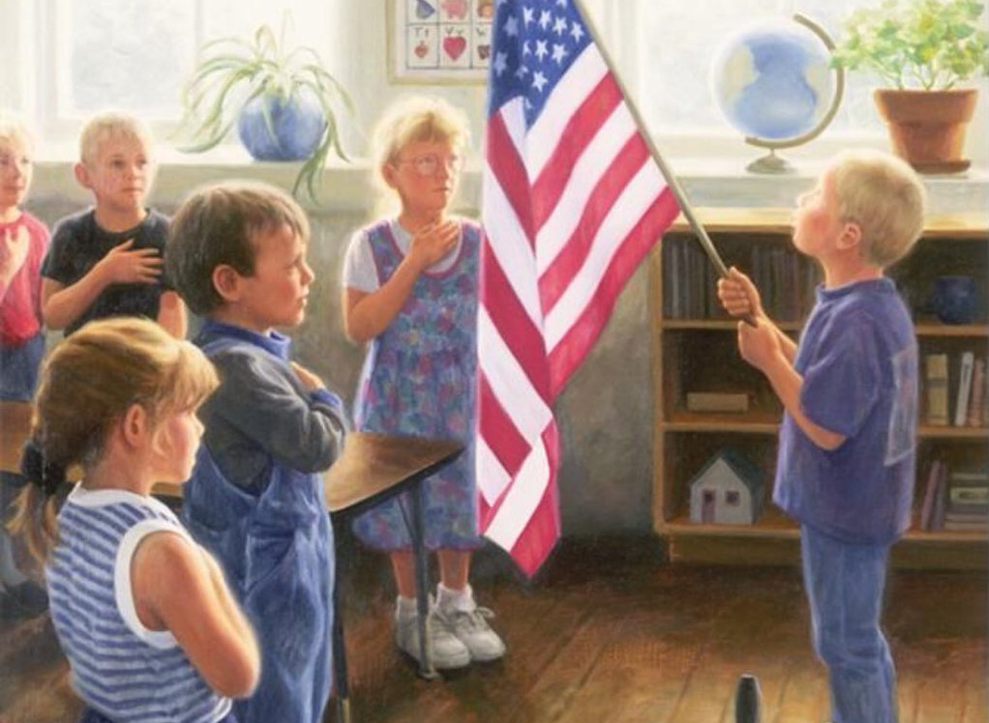
Pledge of Allegiance
Version resembling current pledge began in 1892 by Francis Bellamy
Tweaked periodically, including 1923 & 1924
Hand over heart adopted in 1942 after previous gesture deemed too similar to Nazi salute
1954: “under God” added

Slide 36
Bellamy’s Original
I pledge allegiance to my flag and the republic for which it stands, one nation, indivisible, with liberty and justice for all.
1923/24 Revision
I pledge allegiance to the Flag of the United States and to the Republic for which it stands, one Nation indivisible, with liberty and justice for all.
1954 Revision
I pledge allegiance to the Flag of the United States of America, and to the Republic for which it stands, one Nation under God, indivisible, with liberty and justice for all.
Notes:
https://www.history.com/news/who-created-the-pledge-of-allegiance for lecture notes & reasons for the changes

Slide 37
Seal of the United States
Reverse (Back)
3 committees from 1776-1782
Primarily designed by Charles Thomsen
Various symbols and meanings
Obverse (Front)

Slide 39
United States Motto
Established in 1956
First appeared on currency in 1864
“E Pluribus Unum” was motto for the Seal of U.S. since 1782 – not official for country

Slide 40
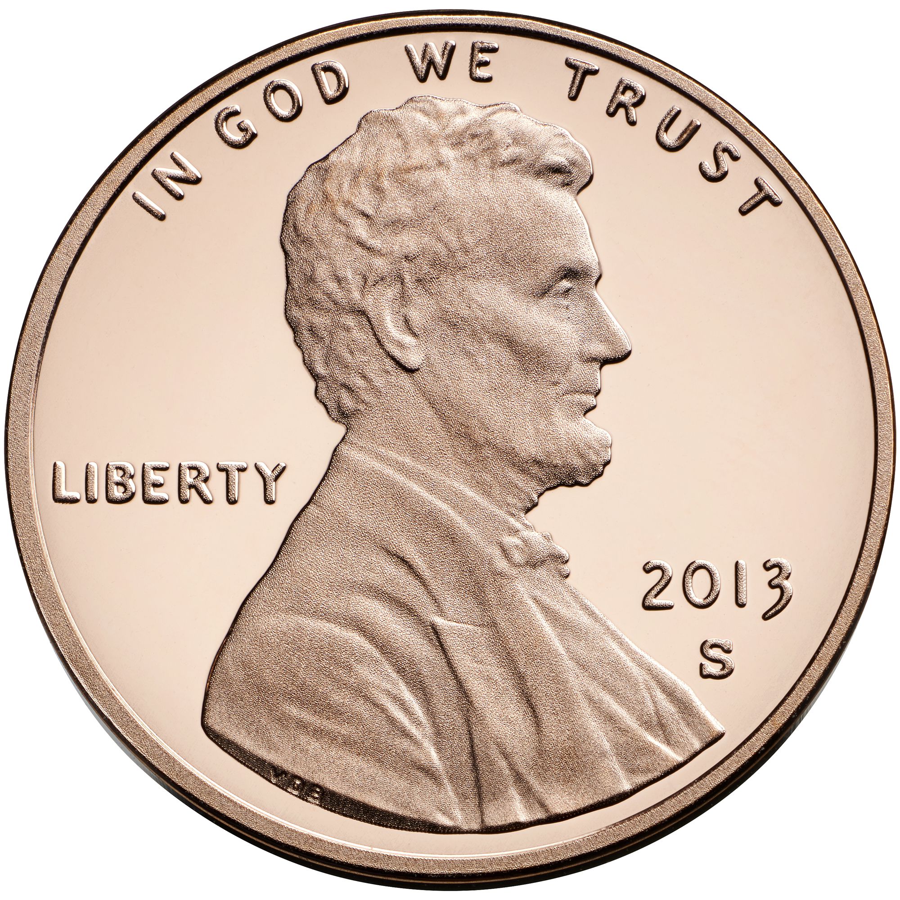
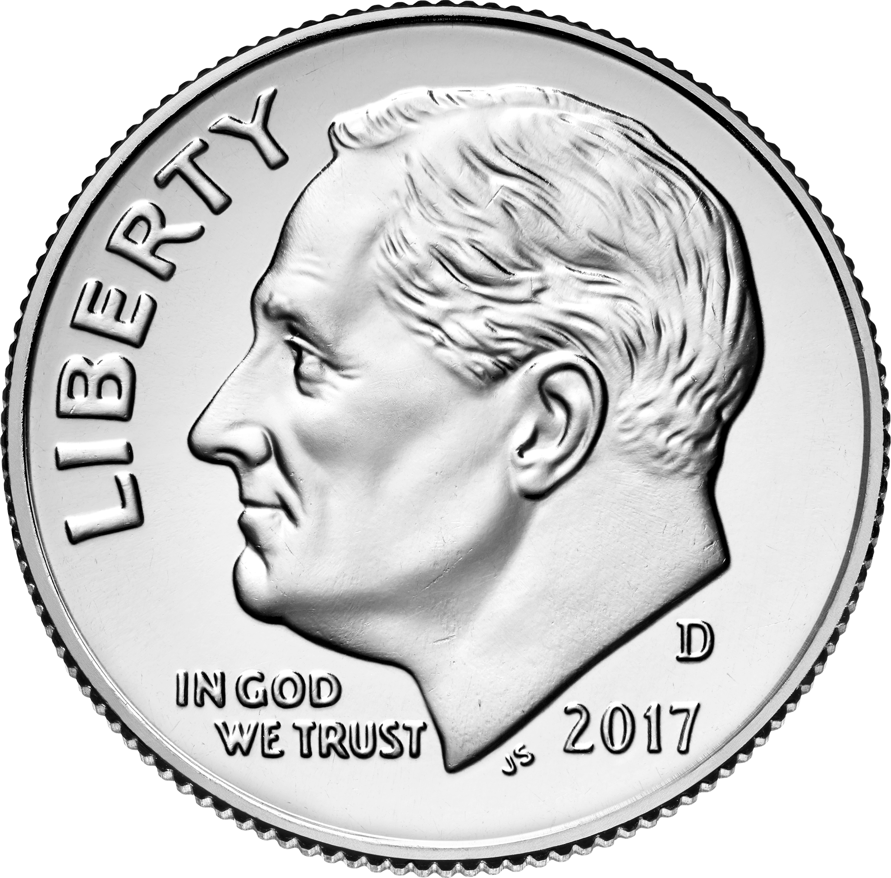
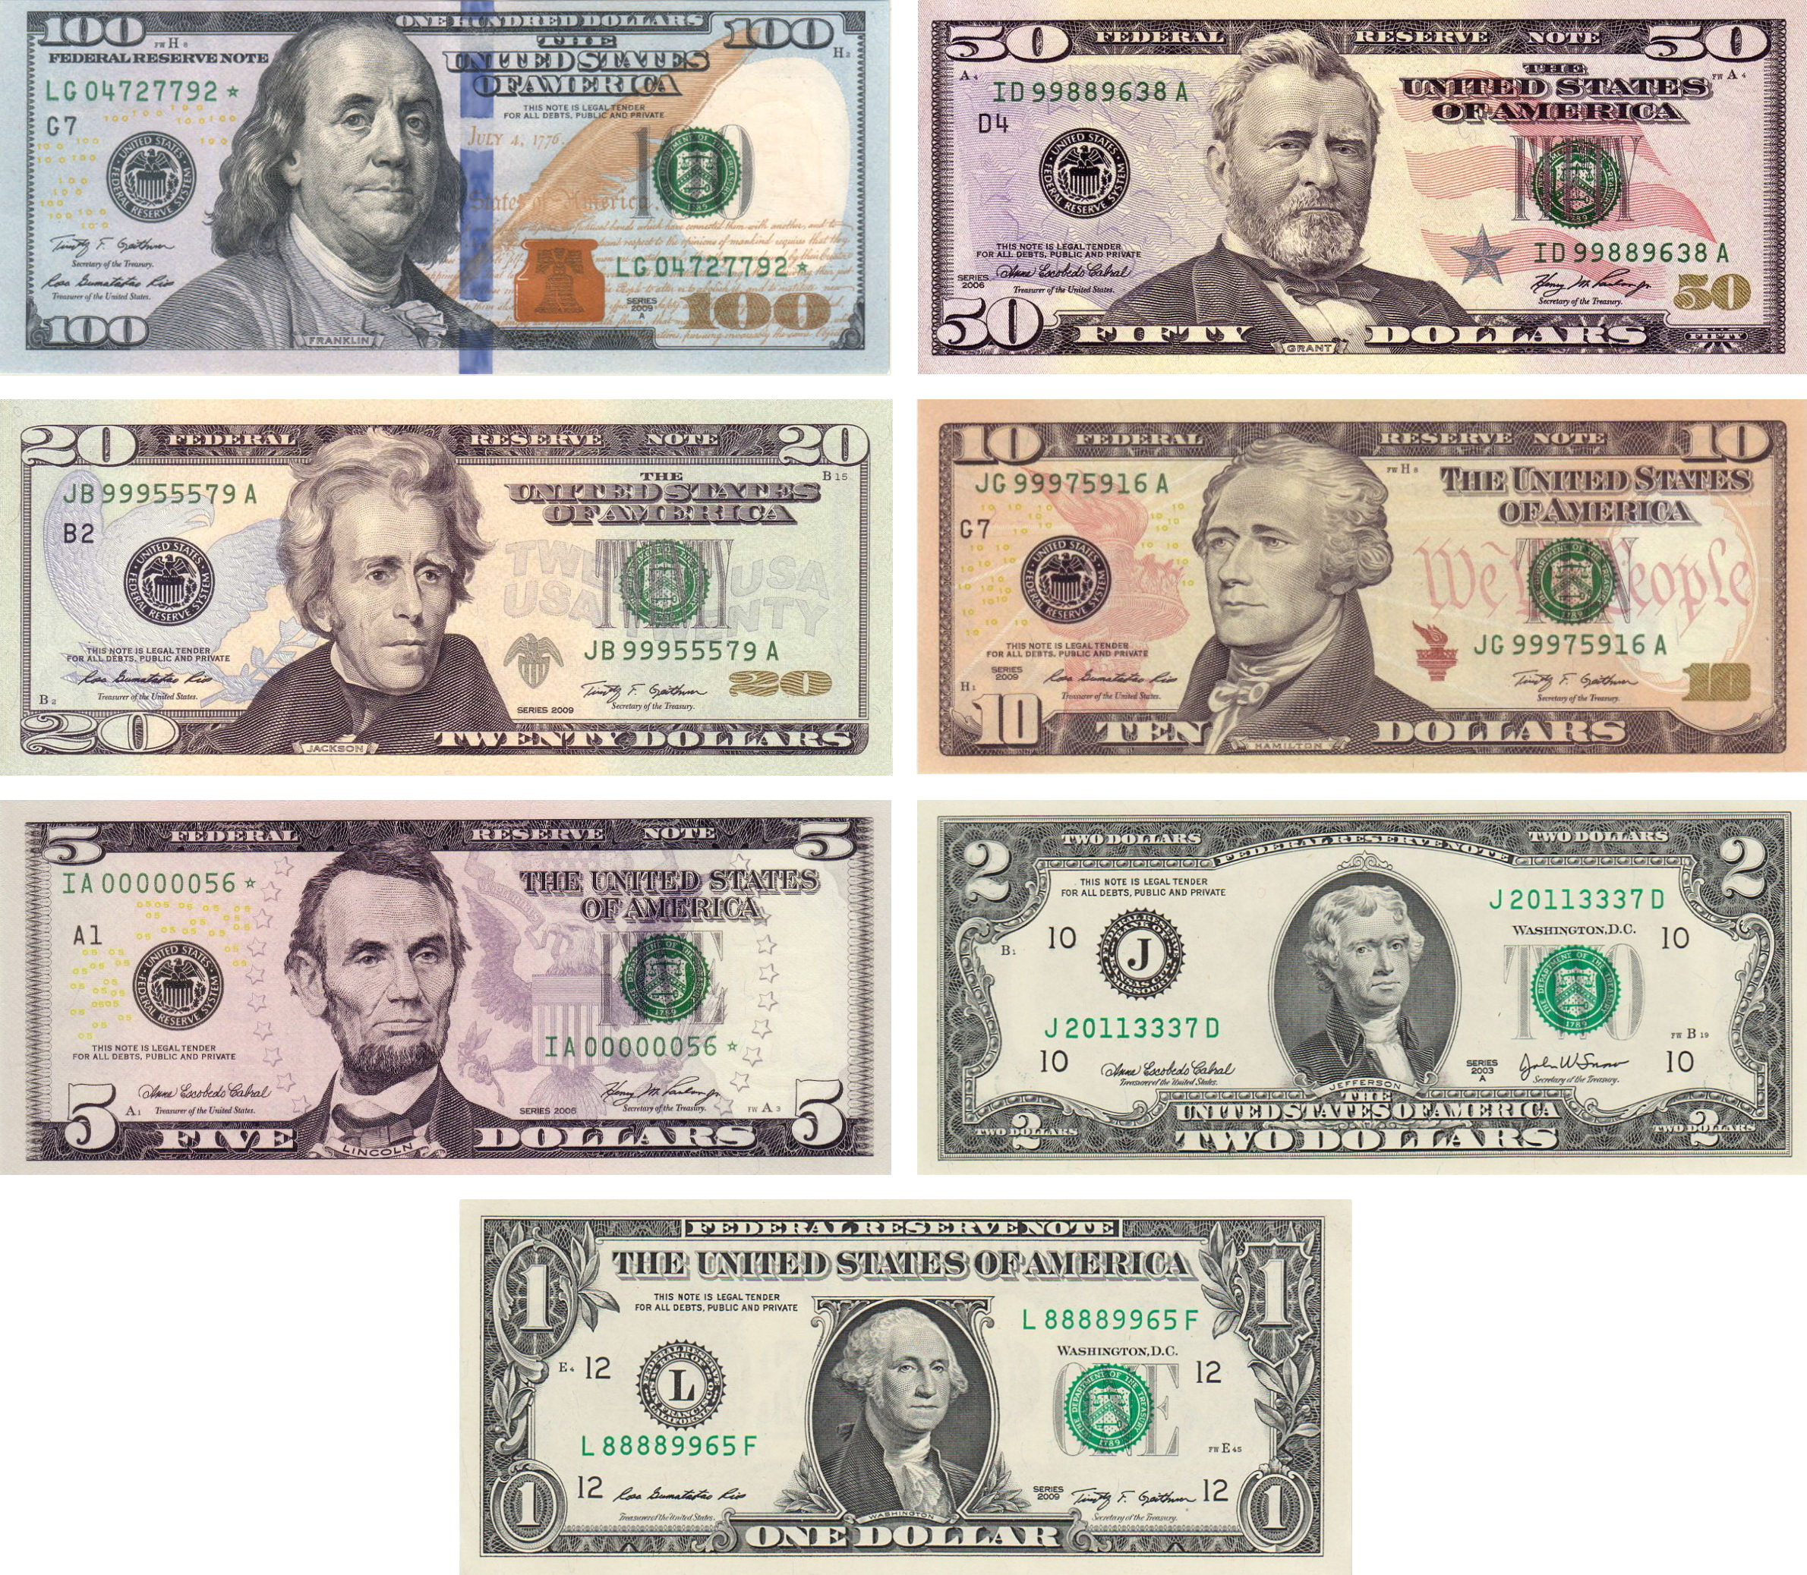
First appeared on pennies in 1909
First appeared on dimes in 1916
Congress required the motto to appear on all paper currency (1956) and on all coins it had previously appeared on (1908).
Began appearing on paper bills in 1957
Notes:
Has appeared continuously on penny and dime since those dates.
NOT required on 1-cent or 5-cent coins (introduced after the 1908 legislation)
https://www.treasury.gov/about/education/Pages/in-god-we-trust.aspx

Slide 41
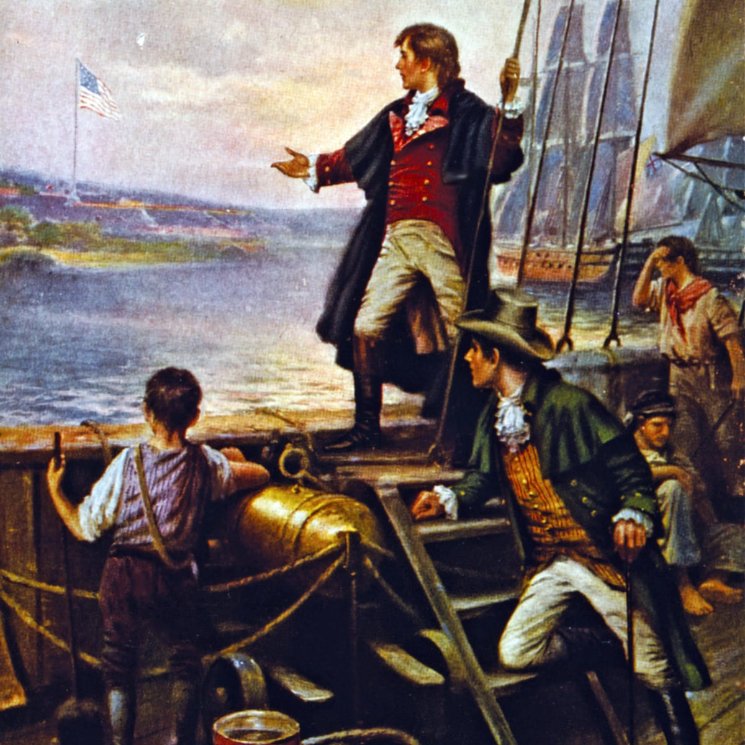
National Anthem
Written by Francis Scott Key in 1814
Originally a poem titled “The Defence of Fort McHenry”
President Wilson announces it should be played at all official events in 1916
Officially adopted as national anthem in 1931

Slide 42
Did you know the National Anthem …
Was set to the tune of a popular British drinking song?
Was inspired by Key witnessing the Battle of Fort McHenry and the lone U.S. flag still flying at daybreak after the British bombardment finished?
Actually has 4 verses/stanzas? Only the first is traditionally sung.
The U.S. flag code describes suggested behavior during the anthem – but that came almost 12 years after the initial adoption of the anthem & has been revised over the years since.

Slide 43
QUESTIONS

Slide 44
Local Events & Places

Slide 45
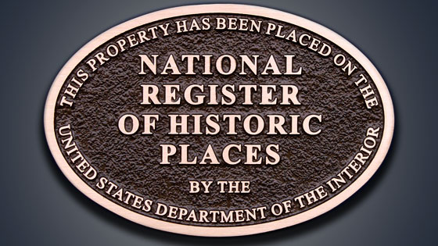
National Register of Historic Places
The United States’ official list of historic places worthy of preservation
Helps support public & private efforts to identify & protect historic sites.

Slide 46
How A Site Is Listed
Usually starts with a nomination form through the State Historic Preservation Office UNLESS property is on federal or tribal land – then it starts with the Federal or Tribal Preservation Office
Site, structure, or property must meet “National Register Critera for Evaluation” (see National Register website).
Two general criteria:
Age & Integrity: Is it old enough to be considered historic AND does it look the way it did in the past?
Significance: Is it associated with events, activities, developments, or people who were important in the past? Does it represent a historically significant architectural, landscape, or engineering achievement
Notes:
https://www.nps.gov/subjects/nationalregister/publications.htm - All specific guidelines can be found on this site

Slide 47
How A Site Is Listed
SHPO notifies affected owners and local governments and solicits public comment. If the owner (or a majority of owners for a district nomination) objects, the property cannot be listed but may be forwarded to the National Park Service for a Determination of Eligibility (DOE).
Proposed nominations are reviewed by your state’s historic preservation office and the state’s National Register Review Board. The length of the state process varies but will take a minimum of 90 days.
Complete nominations, with certifying recommendations, are submitted by the state to the National Park Service in Washington, D.C. for final review and listing by the Keeper of the National Register of Historic Places. The National Park Service makes a listing decision within 45 days.
Notes:
https://www.nps.gov/subjects/nationalregister/how-to-list-a-property.htm – step-by-step guide for how to list a property

Slide 48
QUESTIONS

Slide 49
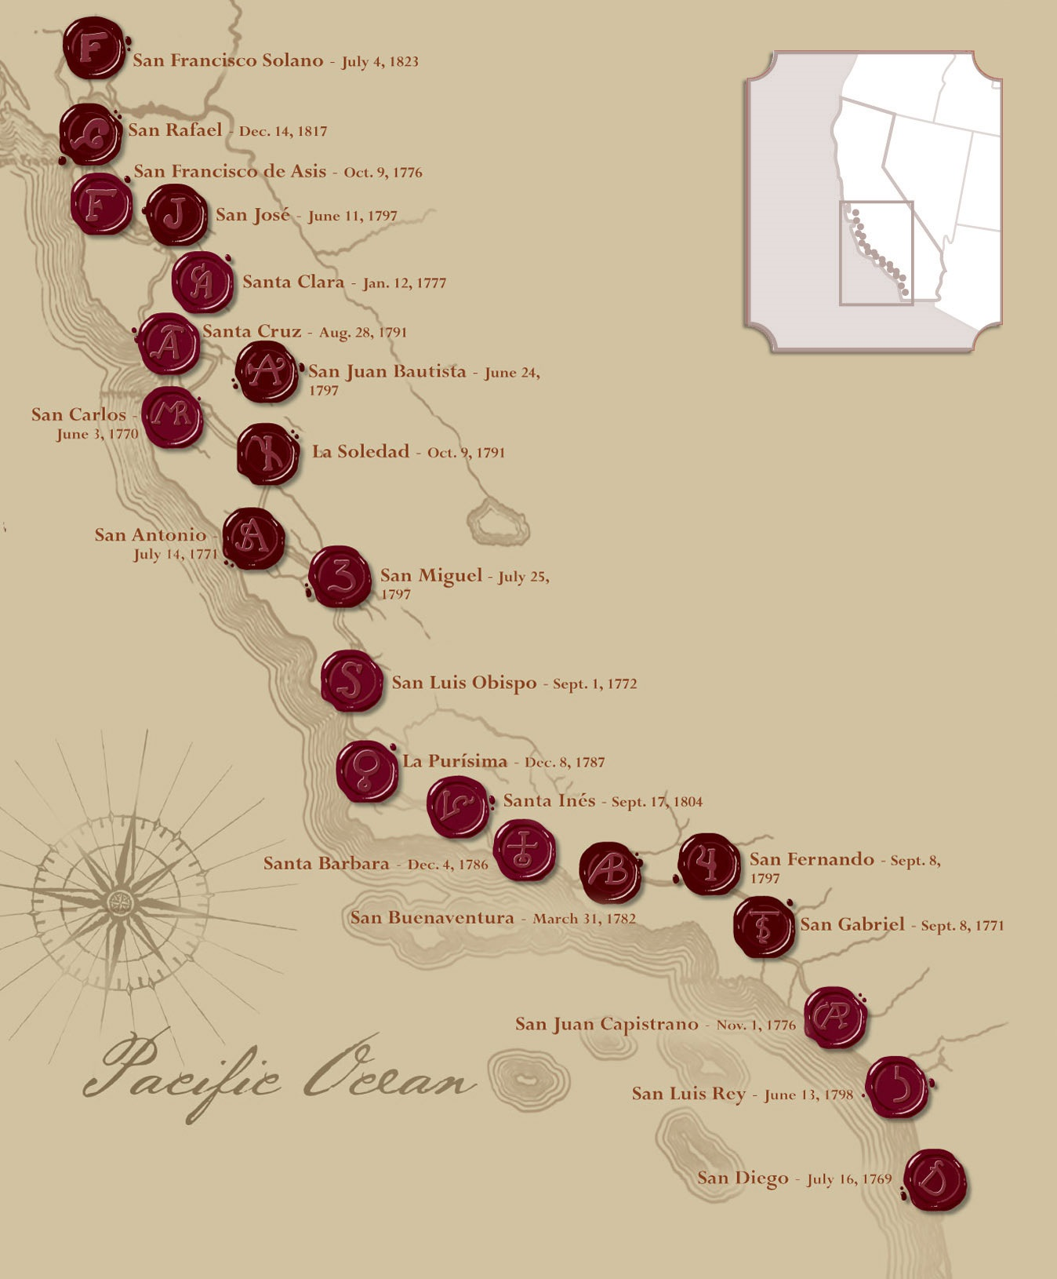
Spanish Missions
Founded by Catholic priests to convert Native Americans and provide a foothold for Spain on the frontier
21 major missions in California

Slide 50
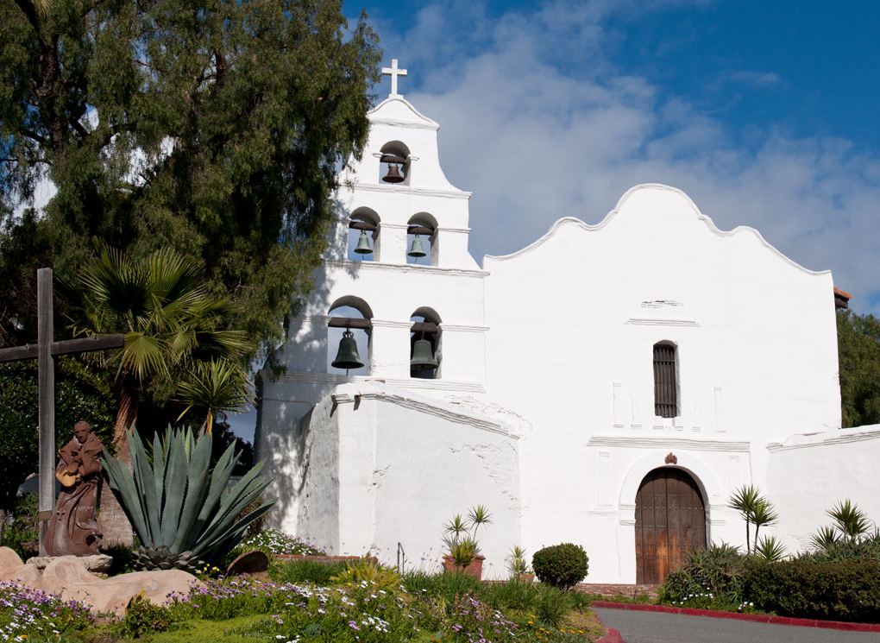
Spanish Missions
Surviving missions are some of California’s oldest structures
Responsible for the founding of many major cities in California, including: Los Angeles, San Francisco, San Jose, San Diego

Slide 51
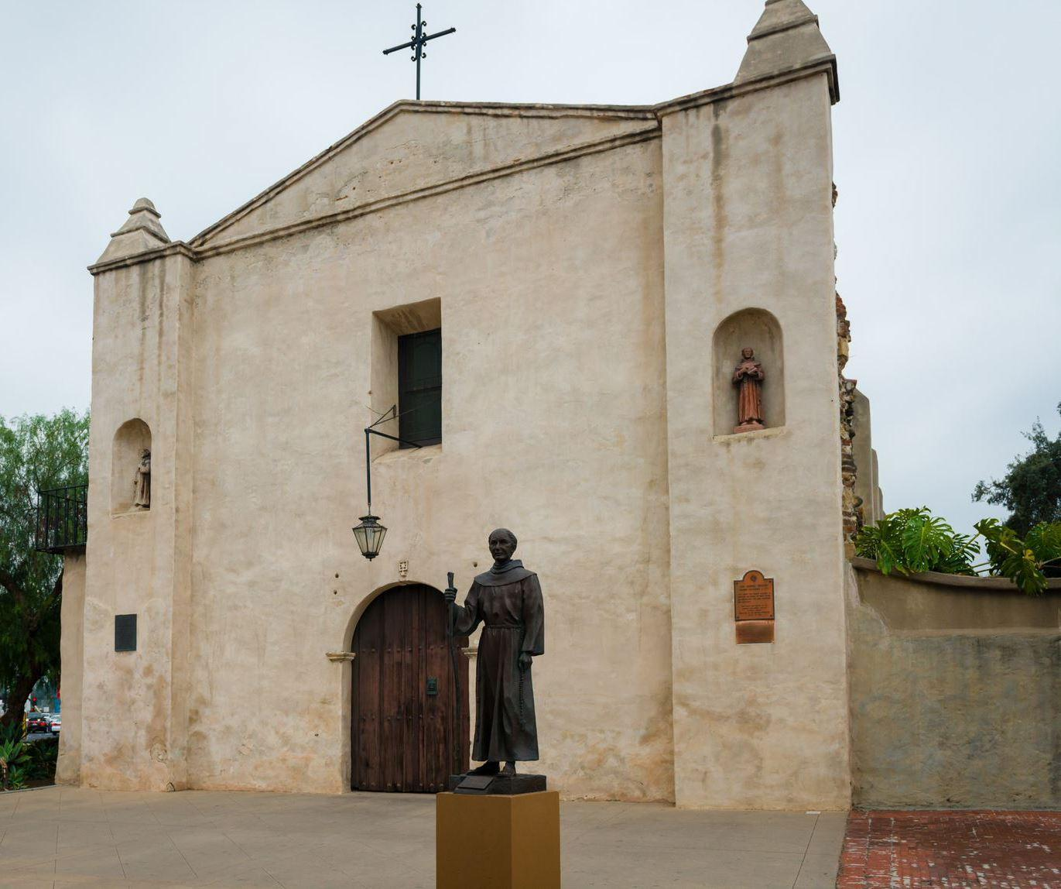
Spanish Missions
San Gabriel Mission had an asistencia (sub-mission) in what is now Redlands
Also contributed to the founding and settling of San Bernardino and the San Bernardino Valley by Europeans

Slide 52
Spanish Missions
Then & Now:
Rural vs. urban
Sparsely populated
Other influences

Slide 53
QUESTIONS

Slide 54
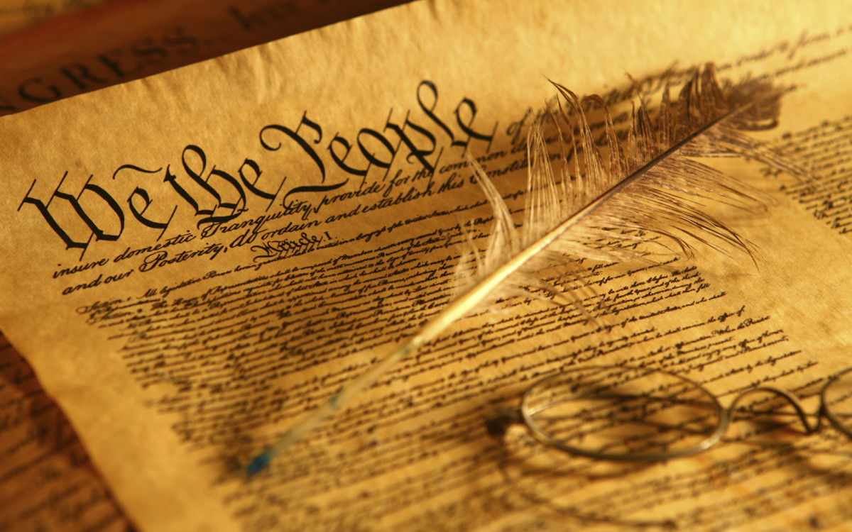
Careers in American Heritage

Slide 55
Careers in American Heritage
Historian
Museum Curator
Museum Technician
Archivist
Librarian
Teacher
Writer

Slide 56
Education, Training, & Preparation
Education
Degree Specialization
Advanced Degree
Technical Training
Training
Writing
Historical Research
Preservation of objects
Communication skills
Preparation
Internship
Self-Study
Research & Study Habits

Slide 57
QUESTIONS

