Slide 1

Welcome to the
2019
Popcorn Orientation
California Inland Empire Council, BSA

Slide 2
Today’s Objectives
Why sell popcorn?
2019 Product Lineup
Commissions
Prizes, Rewards, and Incentives
Merchandising Techniques
Popcorn Kernel Responsibilities
How to Set and Reach a Goal
Online Sales
Q & A / Closing

Slide 3
Why Sell Popcorn?

Slide 4
Why sell popcorn?
In 2018 over $700,000 went directly to CIEC units
It’s the only fundraiser you will need
Allow your unit to stop worrying about money to operate
Fund your ideal year of Scouting
Pay for Recharter / Re-register
Attend Camp and hold fun Pack events
Budget; awards, derby cars, etc.
In 2018, 220 Scouts earned free Summer Camp
Less fundraising = More fun

Slide 5
2019 Product Lineup

Slide 6

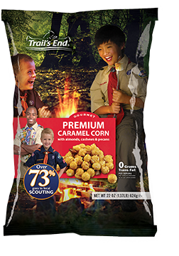
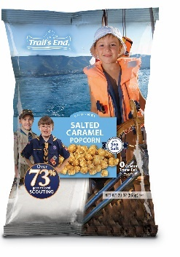
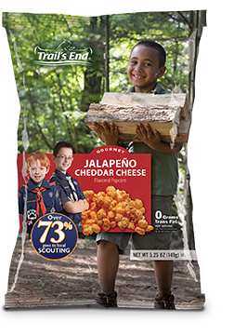
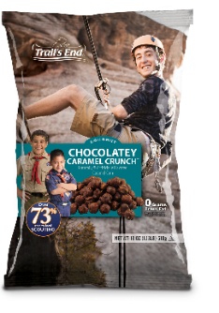
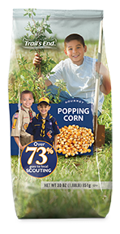
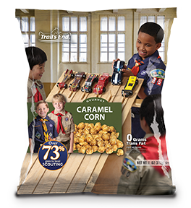
Ready-to-Eat Lineup: Bags
$20
$20
$25
$20
$25
Caramel Corn
w/ Almonds, Cashews & Pecans
White Cheddar Cheese NEW LARGER SIZE
Salted Caramel
Corn
Jalapeno Cheddar NEW LARGER SIZE
Chocolatey Caramel Crunch
$10
$10
Popping Corn
Classic Caramel Corn

Slide 7
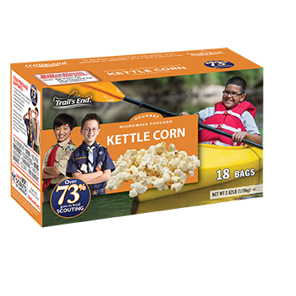
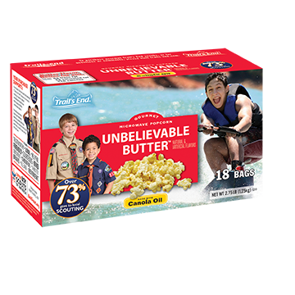
Microwave Lineup
$22
$20
$20
Kettle Corn – 18 Pack
Unbelievable Butter – 18 Pack

Slide 8

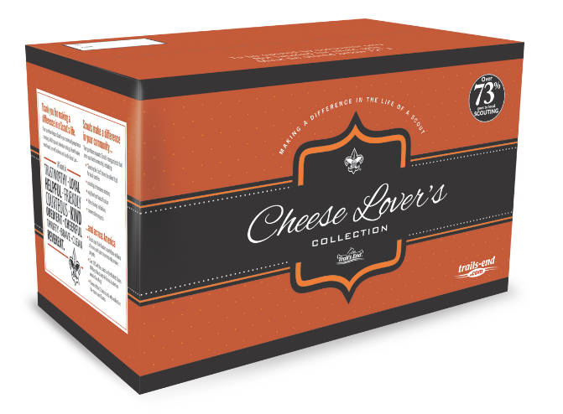
Collection Lineup
$60
$35
$25
Chocolate Lover’s Collection Tin
Cheese Lover’s Collection Box

Slide 9
2019 Commissions

Slide 10
2019 Unit Commissions
Commission Rate
Tier 1: $0 - $4,999 26%
Tier 2: $5,000 - $14,999 unit receives a $200 Scoutshop gift card 28%
Tier 3: $15,000 - $24,999 unit receives a $400 Scoutshop gift card 30%
Tier 4: $25,000 + unit receives a $600 Scoutshop gift card 33%
Attend a council popcorn orientation +2%
Opt out of the Council Prize Program +3%
Total possible unit popcorn Commission: 38%

Slide 11
Scout Prizes, Awards, and Incentives

Slide 12
Incentives
Each Scout that sells $2,500 in popcorn can go to a CIEC Summer camp for FREE!
Each Scout that is in the top 75 in sales and sells at least $2,500 in total sales qualifies for an invite to the Spin and Win Party!
Each Scouts that sells $2500 in popcorn will receive FREE tickets to the Ontario Reign Hockey Scout Night!
Scouts earn Scoutshop gift cards by reaching goals!

Slide 13
Very Important Popcorn Sellers earn

Slide 14
New this year
Strictly for Scouts BSA Troops and Crews
Scouts who register to attend either The National Jamboree or a National High Adventure Base can receive a 15% bonus paid directly to their Jamboree or Adventure Base balance!

Slide 15
Merchandising
Notes:
Dunagan, Stuart & Weaver - Bring up Luke and congratulate him, give him an award and do a brief 5 to 10 minute overview and audience Q&A.

Slide 16
Marketing
87% of consumers cited “Supporting the Scout” as the reason to purchase popcorn
Work with your District Kernels to secure fundraising locations
Do not devalue the popcorn fundraiser by trying to sell or promote non-popcorn items
Do not open and sell individual packages

Slide 17
Presentation
Scouts should appear in uniform
Have a clean area
Know the product and the pricing
Scouts should practice their presentation
  Get the customers attention
  Make eye contact
  Ask them would they like to support Scouting
  Prepare an example of what their support will provide
  Thank them for their support

Slide 18
Sample Table Layout

Slide 20
Unit Kernel Responsibilities…
Notes:
Dunagan, Stuart & Weaver - Bring up Luke and congratulate him, give him an award and do a brief 5 to 10 minute overview and audience Q&A.

Slide 21
What is the Kernels Role
Be the “GO TO” person for your unit! Coordinate and promote the Popcorn Sale in your unit and assist unit leaders in setting a unit sales goal
Contact all the Scouts in your unit and encourage their participation in the sale
Facilitate a Unit Kick Off

Slide 22
Submit all orders on time (show and sell, mid sale, and take order)
Coordinate your unit popcorn pick up(s). Be sure to bring a volunteer(s) to help you
Coordinate with your Scouts and District Kernel dates and times to sell at stores

Slide 23
Distribute popcorn in your unit and ensure money is collected
Maintain inventory count and manage inventory to minimize returns to council
Make sure you turn in all forms on time to ensure your unit will receive all awards, and incentives

Slide 24
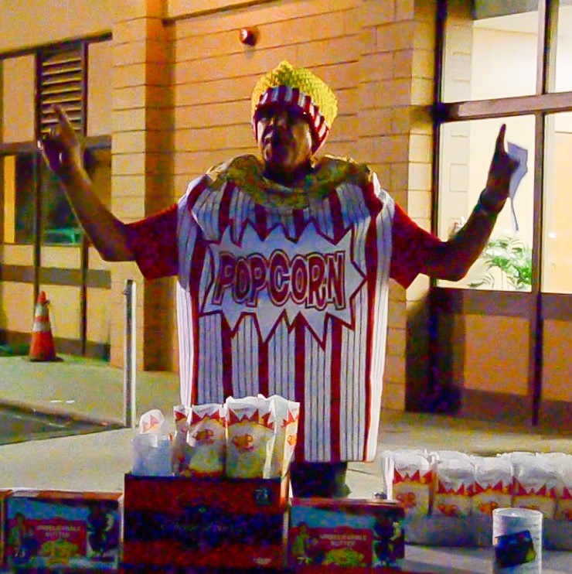
Hold a kickoff!
FACT: 93% of Units that sold $6K+ and Scouts that sold $500+ held/attended a unit kick off
Notes:
Dunagan

Slide 25
What is a kickoff?
Schedule a special Pack or Troop meeting to launch the Popcorn program and the Incentive and Reward Program.
Make this a big deal – get refreshments, make it fun and let everyone know the importance of their participation.
Train the Scouts on their presentation, how to deal with all types of potential customers, teach them how to “ask for the order”, take some time to “role play” and have the Scouts practice in front of the group.
Give them the skills that will inspire confidence and lead to SUCCESS!

Slide 26
Setting and Reaching Goals!

Slide 27
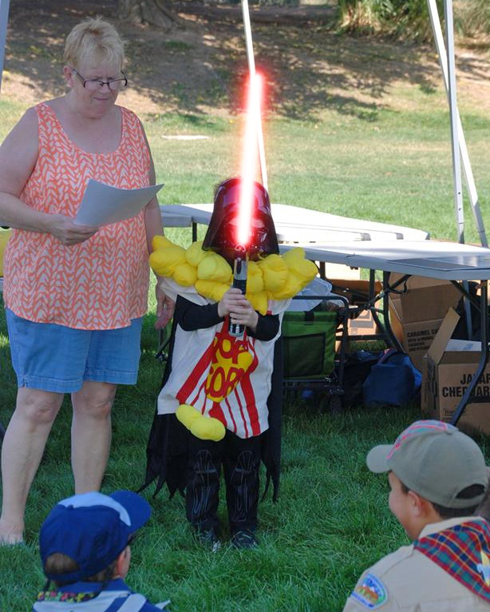

Goals make a difference
  FACT: Sales of Units and Scouts that set sales goals were almost 2X higher than those that did not set goals
Notes:
Dunagan

Slide 28
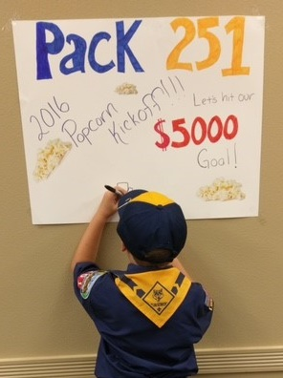
Steps For Reaching Goal
Look at your annual budget and set a GOAL
Get your committee engaged with the sale
Schedule and hold a FUN Kick Off
Share your goal with your families and Scouts
Create a reward if units reaches GOAL
Get the Scouts to create a goal
Work with your District Kernel to secure locations
Participate in all levels of the sale (S&S, TO, and Online)
Share weekly updates with your Scouts and families of top sellers and success stories.
Notes:
Stuart & Walden

Slide 29
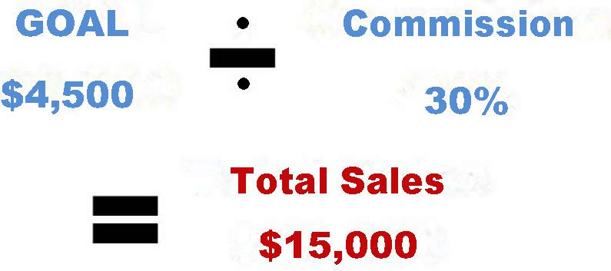
Set a unit goal!

Slide 30
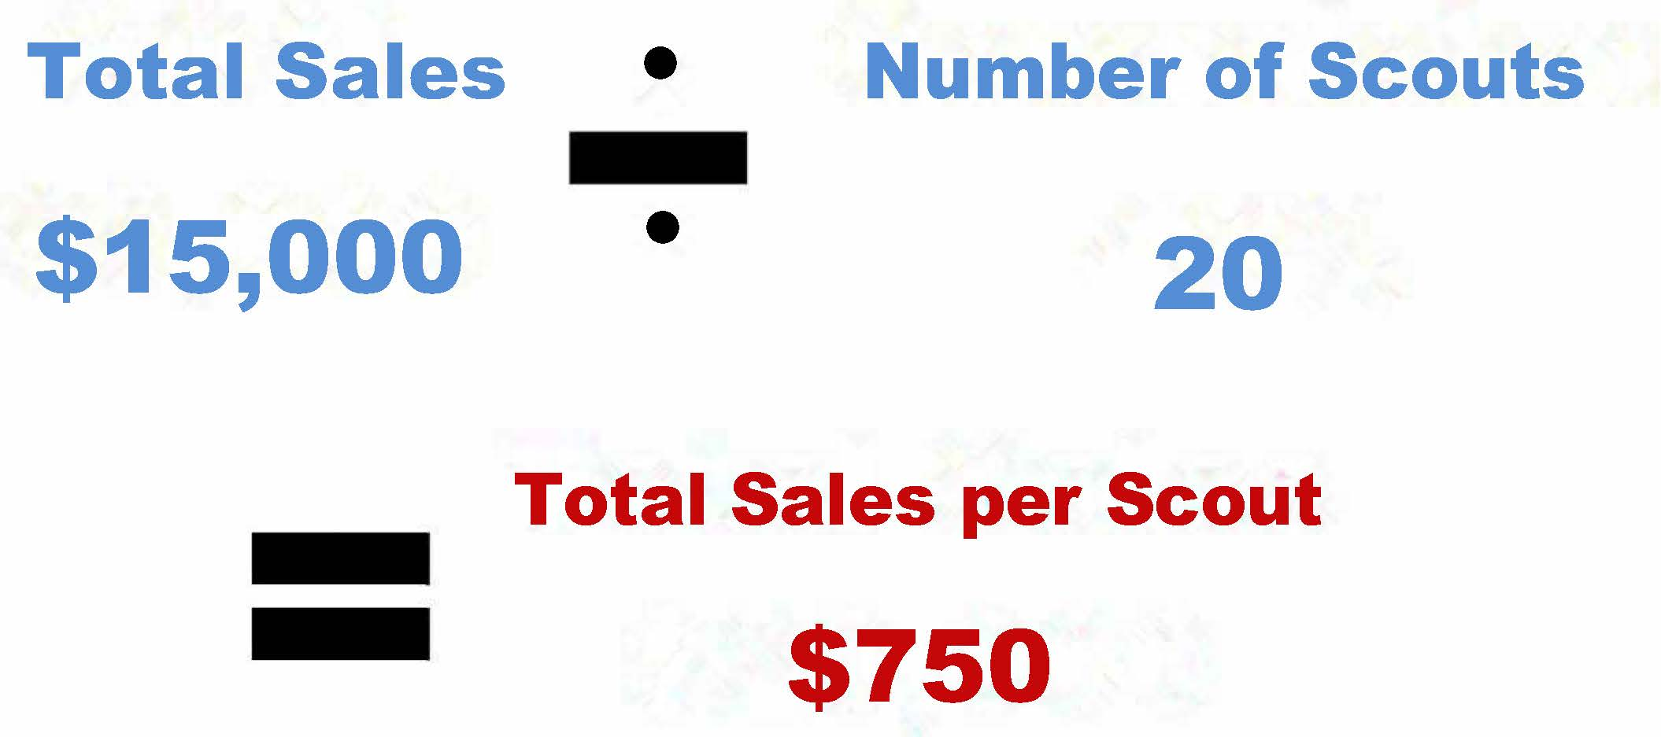
Set an individual Scout goal!

Slide 31
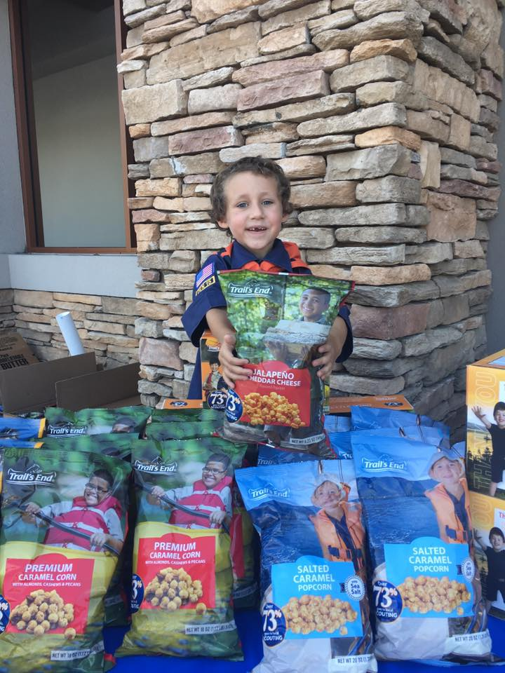
You can expect to fundraise approximately $75 per hour

Slide 32
How do you sell $15,000?
Saturday:
Lowes 10 to 2 = 4 hrs. @ $75 per hr = $ 300
Wal-Mart 8 to 12 = 4 hrs. @ $75 per hr = $ 300
Supermarket 8 to 12 = 4 hrs. @ $75 per hr = $ 300
Supermarket 12 to 4 = 4 hrs. @ $75 per hr = $ 300
Total = $1,200
Sunday:
Best Buy 10 to 2 = 4 hrs. @ $75 per hr = $ 300
Wal-Mart 10 to 2 = 4 hrs. @ $75 per hr = $ 300
Supermarket 10 to 2 = 4 hrs. @ $75 per hr = $ 300
Total = $900
In just
1 weekend
make
$2000

Slide 33
$ $ $ $ $ $ $ $
YOUR POPCORN FUNDRAISER
RUNS FOR
8
WEEKS!

Slide 34
Starting order for a NEW or small unit!

Slide 35
Increase your goal increase your profit

Slide 36
Online Fundraising

Slide 37
Online sales increase revenue
  63% of units who sold online met their goal vs. the 37% that did not sell online
  Units also selling online had a 31% higher sale per Scout
  Online sales count towards all awards and incentives
  New this year FREE shipping for online sales
Notes:
Dunagan

Slide 38

This Photo CC BY-NC-ND
Follow your popcorn sale and communicate with other units by joining the Council Facebook group
CIEC-POPCORN

Slide 39
Questions?

Slide 40
Thank you for attending!

